Slide 1
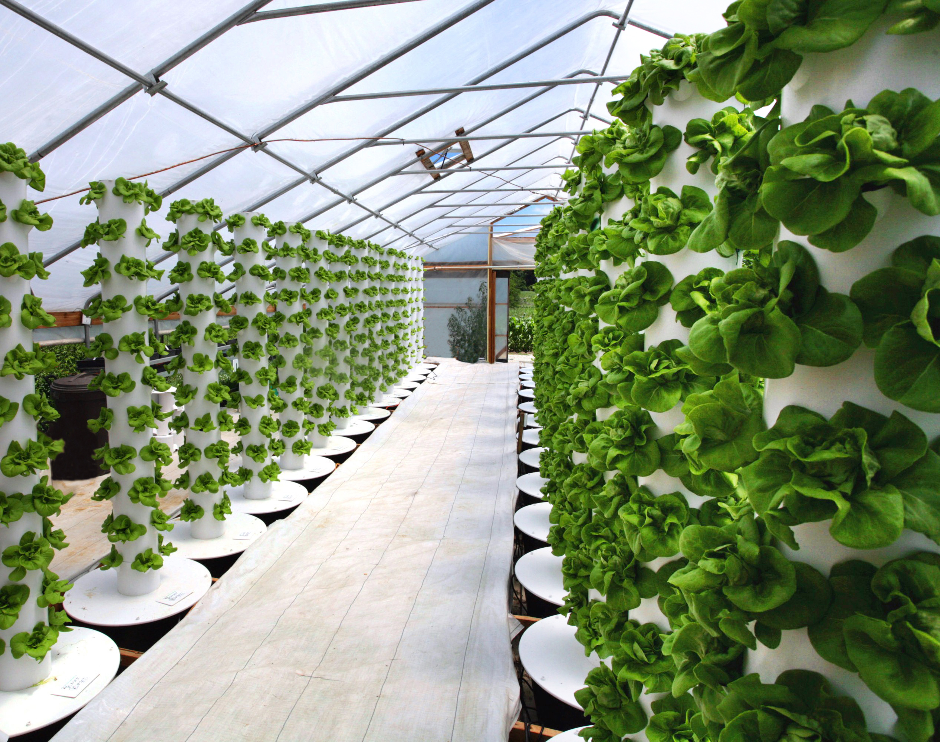
Vertical Farming – Food Sustainability

Slide 2
Availability of Buildings for Upconversion

Slide 3
Greenhouse Urban Cle
Some financials

